Slide 1
Micro Credit Defaulter Project
Vikash Kumar singh

Slide 2
Problem Statement And Understanding
A Microfinance Institution (MFI) is an organization that offers financial services to low-income populations. MFS becomes very useful when targeting especially the unbanked poor families living in remote areas with not much sources of income. The Microfinance services (MFS) provided by MFI are Group Loans, Agricultural Loans, Individual Business Loans and so on.
Many microfinance institutions (MFI), experts and donors are supporting the idea of using mobile financial services (MFS) which they feel are more convenient and efficient, and cost saving, than the traditional high-touch model used since long for the purpose of delivering microfinance services. Though, the MFI industry is primarily focusing on low-income families and are very useful in such areas, the implementation of MFS has been uneven with both significant challenges and successes.
Today, microfinance is widely accepted as a poverty-reduction tool, representing $70 billion in outstanding loans and a global outreach of 200 million clients.
We are working with one such client that is in Telecom Industry. They are a fixed wireless telecommunications network provider. They have launched various products and have developed its business and organization based on the budget operator model, offering better products at Lower Prices to all value conscious customers through a strategy of disruptive innovation that focuses on the subscriber.
They understand the importance of communication and how it affects a person’s life, thus, focusing on providing their services and products to low-income families and poor customers that can help them in the need of hour.
They are collaborating with an MFI to provide micro-credit on mobile balances to be paid back in 5 days. The Consumer is believed to be defaulter if he deviates from the path of paying back the loaned amount within the time duration of 5 days. For the loan amount of 5 (in Indonesian Rupiah), payback amount should be 6 (in Indonesian Rupiah), while, for the loan amount of 10 (in Indonesian Rupiah), the payback amount should be 12 (in Indonesian Rupiah).
The sample data is provided to us from our client database. It is hereby given to you for this exercise. In order to improve the selection of customers for the credit, the client wants some predictions that could help them in further investment and improvement in selection of customers

Slide 3
In general, any machine learning problem can be assigned to one of two broad classifications: Supervised learning and Unsupervised learning.
Supervised Learning: - In supervised learning ,we are given a data set and already know what our correct output should look like, having the idea that there is a relationship between the input and the output. Supervised learning problems are categorized into “regression” and “classification” problems.
In a regression problem, we are trying to predict results within a continuous output, meaning that we are trying to map input variables to some continuous function.
In a classification problem, we are instead trying to predict results in a discrete output. In other words, we are trying to map input variables into discrete categories.
Unsupervised Learning: -Unsupervised learning allows us to approach problems with little or no idea what our results should look like .We can derive structure from data where we don’t necessarily know the effect of the variables. We can derive this structure by clustering the data based on relationships among the variables in the data. With unsupervised learning there is no feedback based on the prediction results.

Slide 4
EDA steps and visualizations :
Cleansing the dataset:
This is an essential step to perform before creating a visualization. Clean, consistent data will be much easier to visualize.
Data cleaning tasks will be very dependent on the dataset that you’re working with. In most cases, data cleaning involves:
Removing unnecessary variables
Deleting duplicate rows/observations
Addressing outliers or invalid data
Dealing with missing values
Standardizing or categorizing values
Correcting typographical errors

Slide 5
Data Visualization:
The data preparation steps involve various type of visualization, which include:
bar plot to check the relationship between categorical and numerical variables.
Scatter plot is used to check the relationship between two variables.
Distplot is used to check the distribution of any variable. A well distributed variable shows bell shape curve. It also analyze the skewness of the variables.
Box plot is to determine the outlier of variables.
Histogram plot is also shown in the model.
Heat map shows for the multicollinearity between variables.
Pair plot is used to create an axis grid for every numerical variable.

Slide 6
Steps and assumptions used to complete the project:
Importing the given dataset
Check the data info
Checking null Values
Checking the duplicate data
Dropping the duplicate data
Dropping the unwanted columns from dataset
Transforming the skewed data by square root Transformation
distribution of numerical features
removing the outliers
histogram plot
Heatmap of numerical variables
Encoding
splitting the target and features
scaling the dataset
splitting the train and test dataset
Machine learning Algorithm
Metrics-Recall, f1 score , precision, cross validation score and roc auc score.
Accuracy; Classification report
Models
Hyperparameter tuning
Saving the model

Slide 7
Models:
Names:
Logistic regression
Random forest classifier
Decision tree classifier
Extra tree classifier
Support vector regressor(SVR)
Kneighbour classifier
GaussianNB
Adaboost classifier
Gradient boosting classifier
Dummy classifier
Accuracy:
87…%
92%
87%
91%
72%
88%
75%
91%
91%
87%

Slide 8
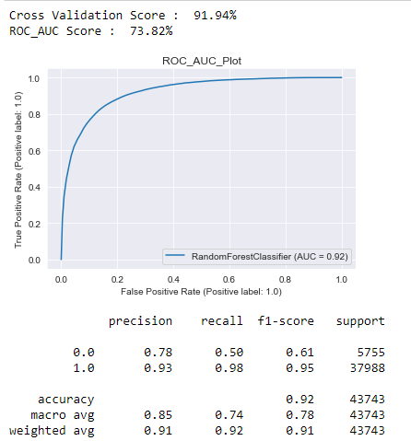
Finalized model:
Model 3; Random forest has highest accuracy and lowest difference between its accuracy and cross validation score.

Slide 9
Conclusion:
The aim of this project was to determine whether the customer will be paying back the loaned amount. In this project Label ‘1’ indicates that the loan has been paid i.e., non-defaulter while, Label ‘0’ indicates that the loan has not been paid i.e., defaulter. In this project, to improve the selection of customers for the credit, the client needs some predictions that could help them in further investment and improvement in selection of customers. we have discovered many algorithms and application of machine learning techniques with the objective to predict the customer is a defaulter or not. We have done first cleaning and exploring of the input data. We have performed Logistic regression, Random Forest classifier, Decision Tree classifier, SVC, KNeighbours classifier, Dummy classifier, GaussianNB, Adaboost classifier, XGB classifier and Gradient boosting classifier and hyperparameter tuning as we understand that parameterization can drive the significant result in the performance.

Slide 10
THANK YOU

